Slide 1
Intrusion Detection Techniques using Machine Learning

Slide 2
What is an IDS?
An Intrusion Detection System is a wall of defense to confront the attacks of computer systems on the internet.
The main assumption of the IDS is that the behavior of intruders is different from legal users.

Slide 3
Types of IDS
Anomaly approaches: Determine whether deviations from normal usage patterns can be flagged as intrusions
Misuse or Signature detection approaches: This kind of approach uses patterns of well-known attacks to identify intrusions.
Clearly Machine Learning is well suited for the first kind of approach.

Slide 4
The 1998/1999 DARPA Intrusion set
The data set contains 24 attack types that could be classified into four main categories:
Denial of Service(DOS),
Remote to User (R2L),
User to Root (U2R), and
Probing
The original data contain 744 MB data with 4,940,000 records.
The data set has 41 attributes for each connection record plus one class label.

Slide 5
Anomaly Detection Systems
Three main parts in anomaly detection system are:
Feature selection
Model of normal behavior
Comparison

Slide 6
Machine Learning Techniques:
Single Classifiers
Hybrid Classifiers
Ensemble Classifiers

Slide 7
Single Classifiers K-Nearest Neighbors (k-NN)
Computes the approximate distance between different points on the input vectors and assigns the unlabeled point to the class of its K-nearest neighbors. The k parameter affects performance and accuracy.
k-NN is instance based learning. It contains no model training stage; only searches for examples of input vectors and classifies new distances.

Slide 8
Liao, Y., & Vemuri, V. R. (2002). Use of K-nearest neighbor classifier for intrusion detection. Computer and Security, 21(5), 439–448.
Li, Y., & Guo, L. (2007). An active learning based TCM-KNN algorithm for supervised network intrusion detection. Computer and Security, 26, 459–467.

Slide 9
Single Classifiers Support Vector Machines (SVM)
SVM maps the input vector into a higher dimensional feature space and obtains an optimal separating hyper-plane in the higher dimensional hyper plane. The decision boundary is determined by support vectors and extremely robust to outliers.

Slide 10
Chen, W.-H., Hsu, S.-H., & Shen, H.-P. (2005). Application of SVM and ANN for intrusion detection. Computer and Operations Research, 32, 2617–2634.
Heller, K. A., Svore, K. M., Keromytis, A. D., & Stolfo, S. J. (2003). One class support vector machines for detecting anomalous window registry accesses. In Paper presented at the 3rd IEEE conference data mining workshop on data mining for computer security. Florida.
Khan, L., Awad, M., & Thuraisingham, B. (2007). A new intrusion detection system using support vector machines and hierarchical clustering. The VLDB Journal, 16, 507–521.
Tian, M., Chen, S. -C., Zhuang, Y., & Liu, J. (2004). Using statistical analysis and support vector machine classification to detect complicated attacks. In Paper presented at the proceedings of the third international conference on machine learning and cybernetics. Shanghai.

Slide 11
Single Classifiers Artificial Neural Networks
Information is processed in units that mimic neurons. Multi-Layer Perceptron: Consists of an input layer including a set of sensory nodes as input nodes, one or more hidden layers of computation nodes and an output layer. Each interconnection has a scalar weight associated with it that is calculated during the training phase.

Slide 12
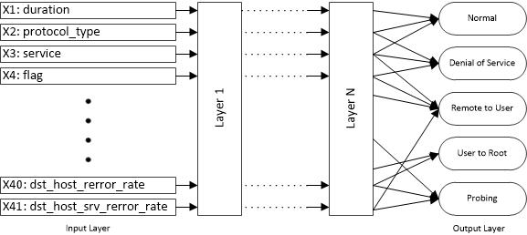
Artificial Neural Networks
Chen, Y., Abraham, A., & Yang, B. (2007). Hybrid flexible neural-tree-based intrusion detection systems. International Journal of Intelligent Systems, 22, 337–352.

Slide 13
Chen, Y., Abraham, A., & Yang, B. (2007). Hybrid flexible neural-tree-based intrusion detection systems. International Journal of Intelligent Systems, 22, 337–352.
Joo, D., Hong, T., & Han, I. (2003). The neural network models for IDS based on the asymmetric costs of false negative errors and false positive errors. Expert System with Applications, 25, 69–75.
Liu, G., Yi, Z., & Yang, S. (2007). A hierarchical intrusion detection model based on the PCA neural networks. Neurocomputing, 70, 1561–1568.
Moradi, M., & Zulkernine, M. (2004). A neural network based system for intrusion detection and classification of attacks. In Paper presented at the proceeding of the 2004 IEEE international conference on advances in intelligent systems – Theory and applications. Luxembourg.
Zhang, C., Jiang, J., & Kamel, M. (2005). Intrusion detection using hierarchical neural network. Pattern Recognition Letters, 26, 779–791.

Slide 14
Single Classifiers Self-Organizing Maps (SOM)
Used to reduce the dimension of data for visualization. SOM projects and clusters high dimensional input vectors into a low dimensional (usually 2) visualization map.
Consists of an Input layer and a Kohonen layer.
The Kohonen layer is a two dimensional arrangement of neurons that maps the n-dimensional input to two dimensions. SOM maps similar input vectors onto the same or similar output units on the two dimensional map. Outputs self-organize to an ordered map and output units with similar weights are placed nearby after training.

Slide 15
Hierarchical SOM architecture (a) Architecture (b) Data partitioning
Kayacik, H. G., Nur, Z.-H., & Heywood, M. I. (2007). A hierarchical SOM-based intrusion detection system. Engineering Applications of Artificial Intelligence, 20, 439–451.

Slide 16
Single Classifiers Decision Trees
A sample is classified through a sequence of decisions, in which the current decision helps to make the subsequent decision. Tree structure where each node is a decision and each leaf a classification category.

Slide 17
Randomly Generated Population
Feature Selection
Decision Tree Constructor
Decision Tree Evaluator
Fitness Computation
Final Decision Tree Classifier
Training Data
Validation
Data
Testing
Data
Generate Next Generation
GA/Decision Tree Hybrid
Stein, G., Chen, B., Wu, A. S., & Hua, K. A. (2005). Decision tree classifier for network intrusion detection with GA-based feature selection. In Paper presented at the proceedings of the 43rd annual Southeast regional conference. Kennesaw, Georgia.

Slide 18
Single Classifiers Naïve Bayes Networks (NBN)
Provides an answer to questions like “What is the probability that it is a certain type of attack, given some observed system events”, by using a conditional probability formula. Usually represented by a directed acyclic graph (DAG), where each node represents one of the system variables and each link encodes the influence of one node upon another.
Scott, S. L. (2004). A Bayesian paradigm for designing intrusion detection systems. Computational Statistics and Data Analysis, 45, 69–83.

Slide 19
Single Classifiers Genetic Algorithms (GA)
Uses the computer to implement the natural selection and evolution. GA usually starts by randomly generating a large population of candidate programs. Some type of fitness measure is used to evaluate the performance of each individual in a population. A large number of iterations is then performed where low performing programs are replaced by genetic recombinations of high-performing programs.
Abadeh, M. S., Habibi, J., Barzegar, Z., & Sergi, M. (2007). A parallel genetic local search algorithm for intrusion detection in computer networks. Engineering Applications of Artificial Intelligence, 20, 1058–1069.
Liu, Y., Chen, K., Liao, X., & Zhang, W. (2004). A genetic clustering method for intrusion detection. Pattern Recognition, 37, 927–942.

Slide 20
Single Classifiers Fuzzy Logic
Fuzzy set theory the degree of truth of a statement is not 0 or 1 but it can range between the two truth values (true/false).
Chavan, S., Shah, K. D. N., & Mukherjee, S. (2004). Adaptive neuro-fuzzy intrusion detection systems. In Paper presented at the in proceedings of the international conference on information technology: Coding and computing (ITCC’04).
Florez, G., Bridges, S. M., & Vaughn, R. B. (2002). An improved algorithm for fuzzy data mining for intrusion detection. In Paper presented at the proceedings of the North American fuzzy information processing society conference (NAFIPS 2002). New Orleans, LA.

Slide 21
Correct
(No Training)
Teacher
Incorrect
(Training Needed)
Winner
(Decision)
Y(1)
Y(2)
Y(3)
Y(n)
Φ₁
Φ₂
Φ₃
Φ_{n}
w₁
w₂
w₃
w_{n}
X(1)
X(2)
X(3)
X(4)
Chavan, Sampada, et al. "Adaptive neuro-fuzzy intrusion detection systems. "Information Technology: Coding and Computing, 2004. Proceedings. ITCC 2004. International Conference on. Vol. 1. IEEE, 2004.

Slide 22
Hybrid Classifiers
Typically consists of two functional components.
• The first one takes raw data a input and generates intermediate results.
• The second one takes the intermediate result as an input and produces the final result.

Slide 23
Examples of Hybrid Classifiers
Cascading classifiers: For example neuro-fuzzy techniques
Clustering based approach to process the input and eliminate outliers, then results are used as training examples for a classifier.
Integrating techniques where the first aims to optimize the learning performance (parameter tuning) of the second model for prediction

Slide 24
Peddabachigari, S., Abraham, A., Grosan, C., & Thomas, J. (2007). Modeling intrusion detection system using hybrid intelligent systems. Journal of Network and Computer Applications, 30, 114–132.
Shon, T., & Moon, J. (2007). A hybrid machine learning approach to network anomaly detection. Information Sciences, 177, 3799–3821.

Slide 25
Hybrid Decision Tree SVM Approach
Support Vector Machine
Intrusion Detection Data
Decision Trees
Peddabachigari, Sandhya, et al. "Modeling intrusion detection system using hybrid intelligent systems." Journal of network and computer applications 30.1 (2007): 114-132.

Slide 26
Shon, T., & Moon, J. (2007). A hybrid machine learning approach to network anomaly detection. Information Sciences, 177, 3799–3821.

Slide 27
Ensemble Classifiers
Combination of multiple weak learners. The learners are trained on different samples to improve the overall performance. To combine the outputs of the weak learners the most common techniques are:
a. Majority Rule
b. Boosting
c. Bagging

Slide 28
Intrusion Detection as a Pattern Recognition Problem
Multiple Classifier System for Intrusion Detection
Giacinto, Giorgio, Fabio Roli, and Luca Didaci. "Fusion of multiple classifiers for intrusion detection in computer networks." Pattern recognition letters 24.12 (2003): 1795-1803.

Slide 29
Neural Networks (Backpropagation)
Neural Networks (Scale Conjugate Gradient)
Data preprocessor
Ensemble
Neural Network (One Step Secant)
Support Vector Machine
Multivariate Regression Splines
Mukkamala, Srinivas, Andrew H. Sung, and Ajith Abraham. "Intrusion detection using an ensemble of intelligent paradigms." Journal of network and computer applications 28.2 (2005): 167-182.

Slide 30
Classification Problems
Inputs are divided into two or more classes, and the learner must produce a model that assigns unseen inputs to one or more of these classes. This is typically tackled in a supervised way.
Anomaly detection can be described as a classification problem: Activities are divided into “normal” and “not normal”.

Slide 31
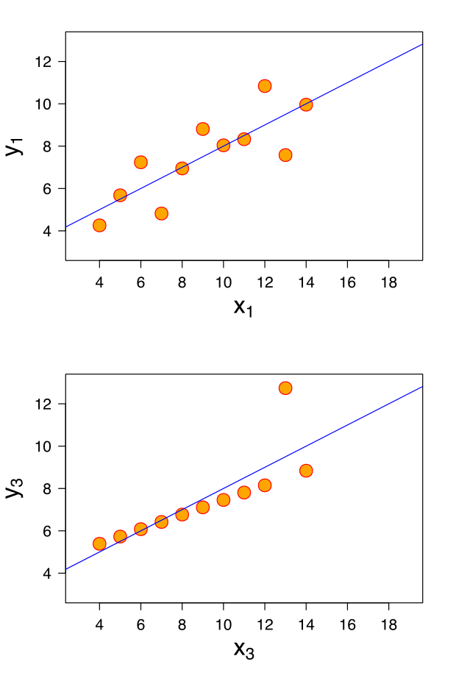
Outlier detection: Closed world assumption
The idea that specifying only positive examples and adopting the standing assumption that the rest are negative… is not of much practical use in real-life problems because they rarely involve “closed” worlds in which you can be certain that all cases have been covered.

Slide 32

High cost of errors
A very small rate of false positives can render a NIDS unusable: operators wasting too much time looking at incident reports of benign activity.
Even one false negative might compromise the entire IT infrastructure.

Slide 33
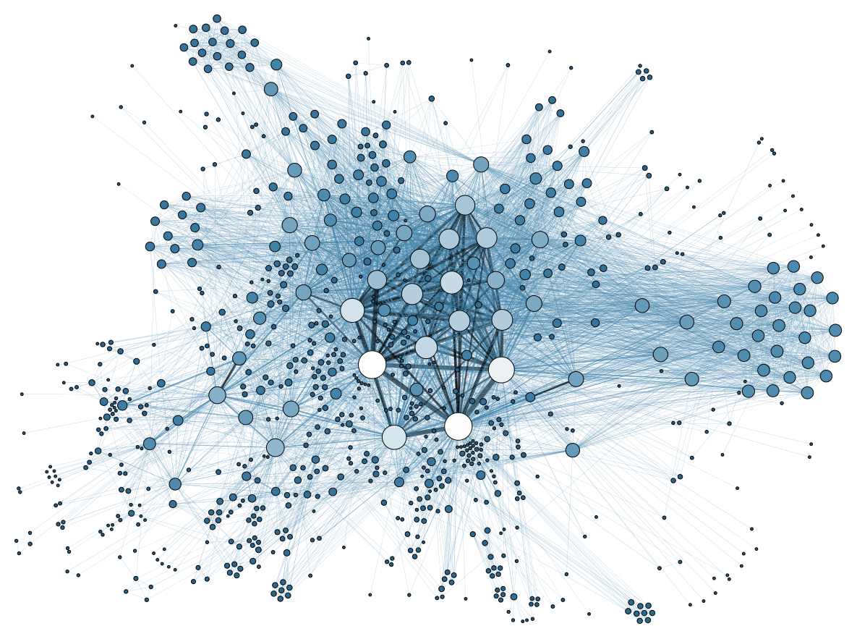
Diversity of network traffic
Network characteristics
Bandwidth
Duration of connections
Application mix
Can vary a lot, rendering them unpredictable over short intervals of time

Slide 34

Semantic gap
It is very challenging to translate the results from a classifier into a report that can be read by a human.
Systems are not designed to identify malicious behavior, but rather, behavior that has not been seen before.

Slide 35

Lack of training Data
Only two publicly available datasets:
DARPA Network traces dataset
KDD Cup dataset.
Best way to train is real network data, but it is difficult to anonymize.
KDD

Slide 36
Recommendations for using machine learning
Understand what the system is doing
Understand the “Threat Model”
Target environment
Attack cost
Who are the attackers
Robustness requirements
Keep the scope narrow
Reduce the costs

